Slide 1

F# Domain Specific Languages
Tomas Petricek @tomaspetricek

Slide 2
software stacks trainings teaching F# user groups snippets mac and linux cross-platform books and tutorials
F# Software Foundation
F# community open-source MonoDevelop
http://www.fsharp.org
contributions research support consultancy mailing list

Slide 3
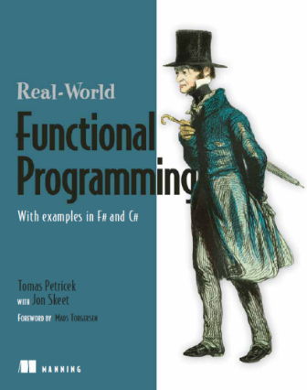
About me
Tomas Petricek
F# contributor since 2006
Finishing PhD at Cambridge
F# consulting & trainings
Recent projects
F# Formatting and documentation tools
Deedle – Explorative data manipulation

Slide 4
Domain Specific Languages

Slide 5
DSL = model + syntax

Slide 6
DEMO DSL for building 3D objects

Slide 7
Domain-specific languages
Class of problems
Constructing 3D objects
Makefiles, Stock modelling, Testing, …
Internal DSL in F#
Primitives – basic building blocks
Composition – how to put them together

Slide 8
DSL for option pricing

Slide 9
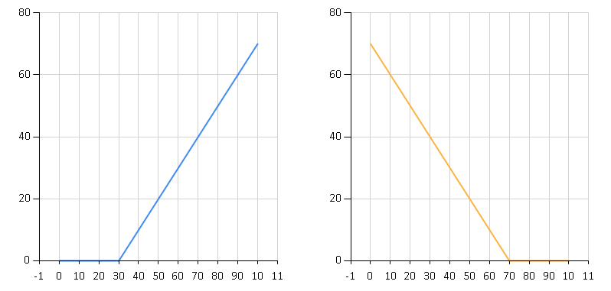
European stock options
Call options
Put options
Option to buy for $30
Option to sell for $30

Slide 10
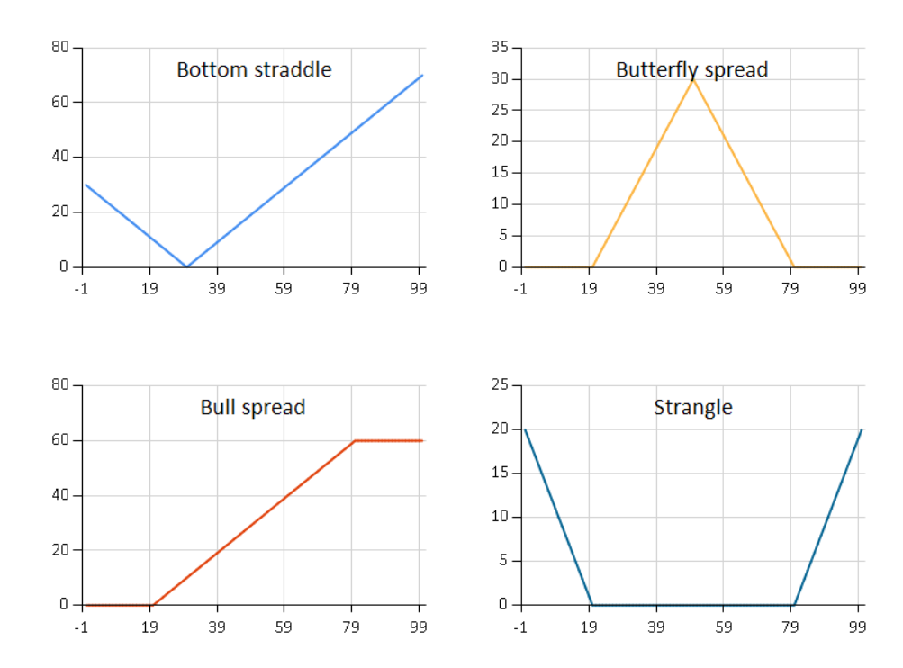
Composed stock options

Slide 11
DEMO Composing stock options

Slide 12
Modeling European options
But we need reusable model!
Drawing a pay-off diagram
Calculating option price
Checking for execution
What is the language?
Primitive values
Composition operations

Slide 13
DEMO DSL for building Stock Options

Slide 14
Demo: Building & using the DSL
Start with domain model
Think & communicate!
Make it more convenient
Custom operators, functions
Add operations over the model
Pay-off diagrams, evaluation, …

Slide 15
DSL for pattern detection

Slide 16
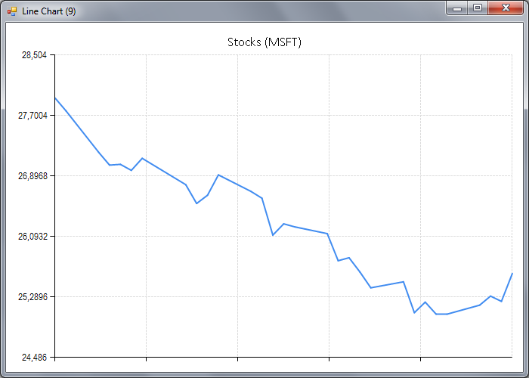
Declining pattern

Slide 17
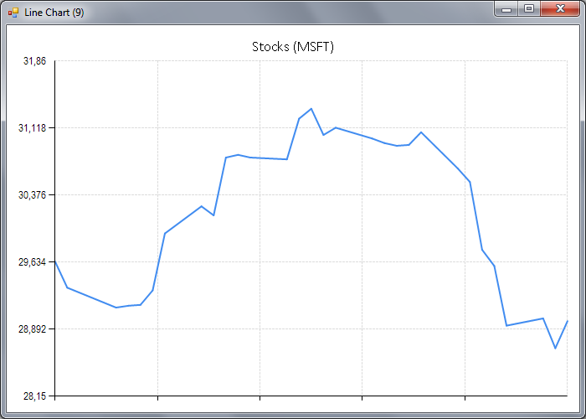
Rounding top pattern

Slide 18
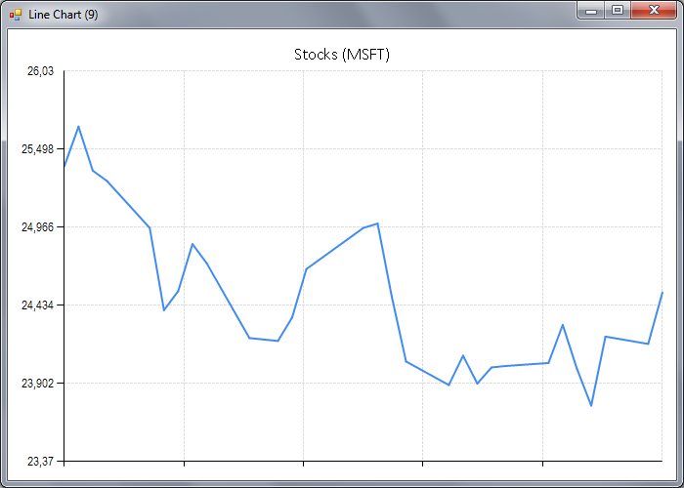
Multiple bottom pattern

Slide 19
Doman-specific language approach
Primitive classifiers
Declining price
Rising price
Combinators for classifiers
Linear regression
Sequence patterns
Parallel patterns

Slide 20
DEMO DSL for detecting price patterns

Slide 21
Markdown parsing using active patterns

Slide 22
Pattern matching
match stock with
| European(Put, name, exercisePrice) -> (* ... *)
| European(Call, name, exercisePrice) -> (* ... *)
| Combine(left, right) -> (* ... *)
| Times(r, option) -> (* ... *)
Language for specifying rules
Identify patterns in the structure
Can be extended too!

Slide 23
DEMO Markdown parser

Slide 24
Active patterns as a DSL
Parsing Markdown documents
Domain specific pattern language
See http://manning.com/petricek2
match input with
| Bracketed '*' '*' (body, rest) -> (* … *)
| Bracketed '[' ']' (body,
Bracketed '(' ')' (link, rest)) -> (* … *)
| _ -> (* … *)

Slide 25
DSL for charting

Slide 26
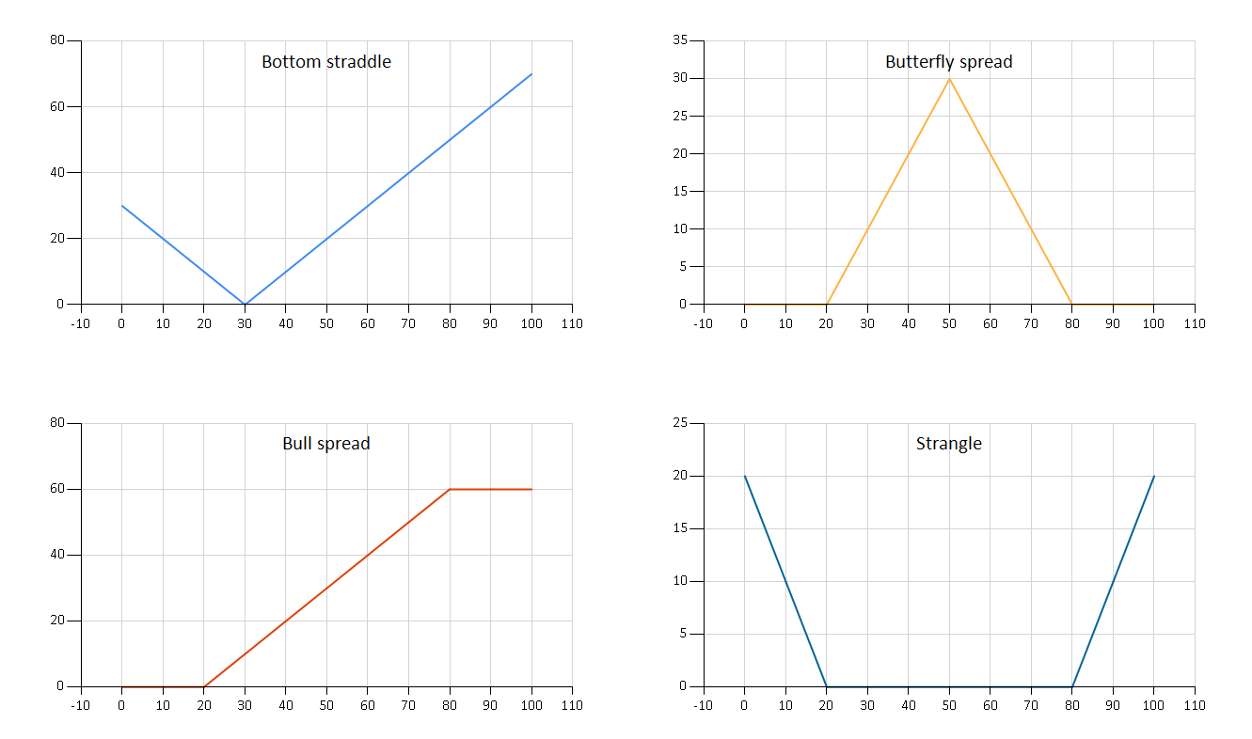
Actually…

Slide 27
Doman-specific language approach
Primitive charts
Line chart, Range chart, …
Bar chart, Column chart, …
Combinators for charts
Side-by-side as rows or columns
Overlay charts in an area
Add title, change colors, …

Slide 28
Summary

Slide 29
How To: Building your own DSL
❶ Understand Primitives and Combinators
❷ Model the language using Discriminated Unions
❸ Add convenient Syntax

Slide 30

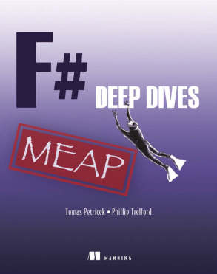
http://fsharp.org software foundation open-source testimonials community
online tutorials http://tryfsharp.org introduction data science visualization finance
industry experts F# Deep Dives domain modeling financial & insurance web & data actor model concurrency social gaming
tomas@tomasp.net consulting Fast Track to F# F# Trainings data processing DSLs asynchronous & concurrent

